Slide 1

Introduction to Probabilistic Machine Learning
Ralf Herbrich
Graphical Models: Approximate Inference

Slide 2
Overview
Distance Measures for Distributions
Approximating Marginals: Expectation Propagation
Approximating Normalization Constants

Slide 3
Overview
Distance Measures for Distributions
Approximating Marginals: Expectation Propagation
Approximating Normalization Constants

Slide 4


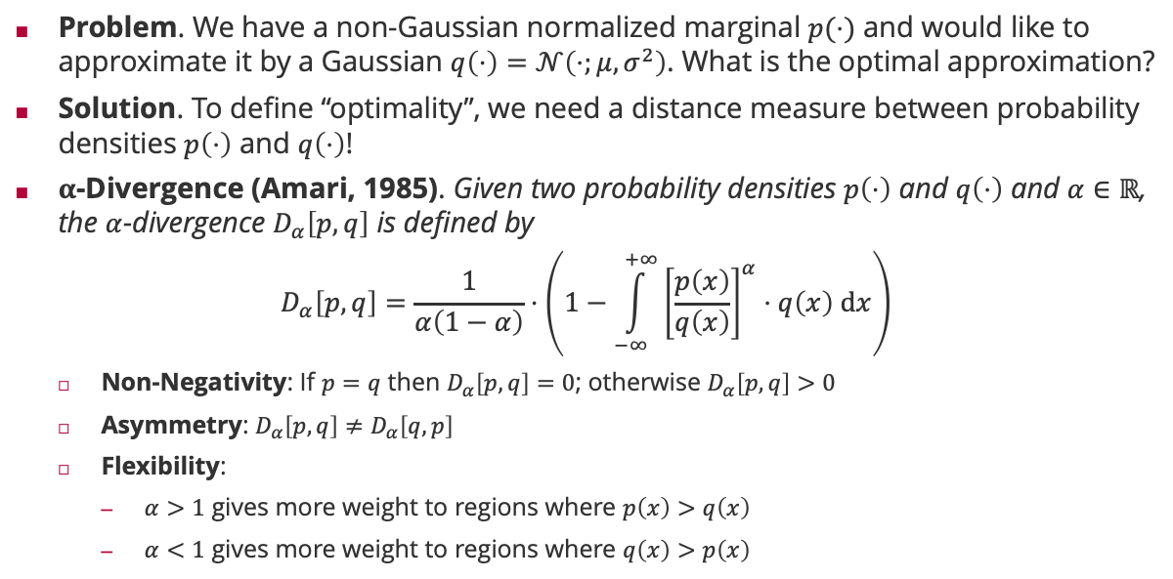


Distance Measures: $α$-Divergence
Problem. We have a non-Gaussian normalized marginal $p(⋅)$ and would like to approximate it by a Gaussian $q\left(⋅\right)=𝒩\left(⋅;μ,σ^{2}\right)$. What is the optimal approximation?
Solution. To define “optimality”, we need a distance measure between probability densities $p\left(⋅\right)$ and $q\left(⋅\right)$!
$α$-Divergence (Amari, 1985). Given two probability densities $p\left(⋅\right)$ and $q\left(⋅\right)$ and $α∈ℝ$, the $α$-divergence $D_{α}\left[p,q\right]$ is defined by
$$D_{α}\left[p,q\right]=\frac{1}{α\left(1−α\right)}⋅\left(1−\int_{−∞}^{+∞}{{\left[\frac{p\left(x\right)}{q\left(x\right)}\right]}^{α}⋅q\left(x\right) dx}\right)$$
Non-Negativity: If $p=q$ then $D_{α}\left[p,q\right]=0$; otherwise $D_{α}\left[p,q\right]>0$
Asymmetry: $D_{α}\left[p,q\right]≠D_{α}\left[q,p\right]$
Flexibility:
$α>1$ gives more weight to regions where $p\left(x\right)>q\left(x\right)$
$α<1$ gives more weight to regions where $q\left(x\right)>p\left(x\right)$
Shun'ichi Amari (甘利 俊) (1936)
Expectation of ${\left[\frac{p\left(x\right)}{q\left(x\right)}\right]}^{α}$ over $q\left(x\right)$
If $p=q$ then ${\left[\frac{p\left(x\right)}{q\left(x\right)}\right]}^{α}=1$ and the expectation is $1$

Slide 5
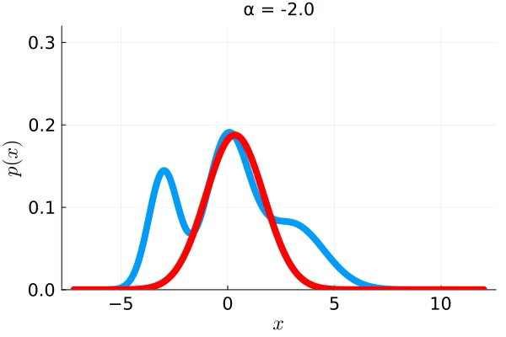







$α$-Divergence with a Gaussian in Pictures
zero-forcing & mode seeking
inclusive & support seeking
$$α$$
$$α=−∞$$
$$α=−1$$
$$α=0$$
$$α=1$$
$$α=+∞$$

Slide 6

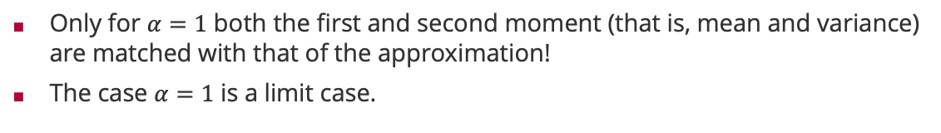
$α$-Divergence with a Gaussian and Moment Matching
Only for $α=1$ both the first and second moment (that is, mean and variance) are matched with that of the approximation!
The case $α=1$ is a limit case.

Slide 7

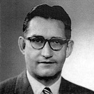
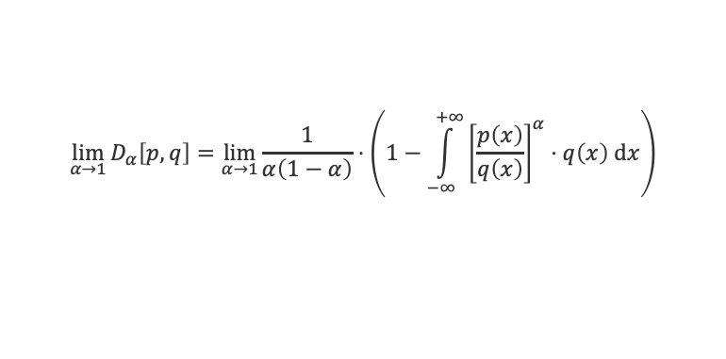
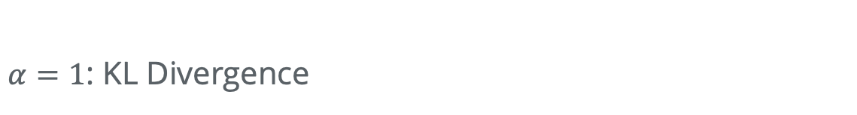
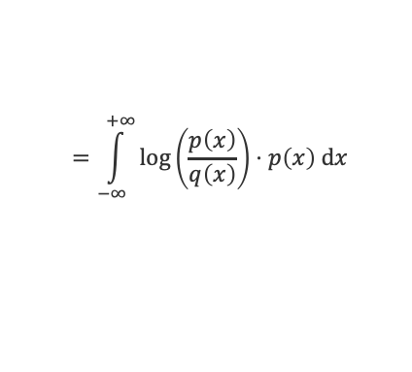
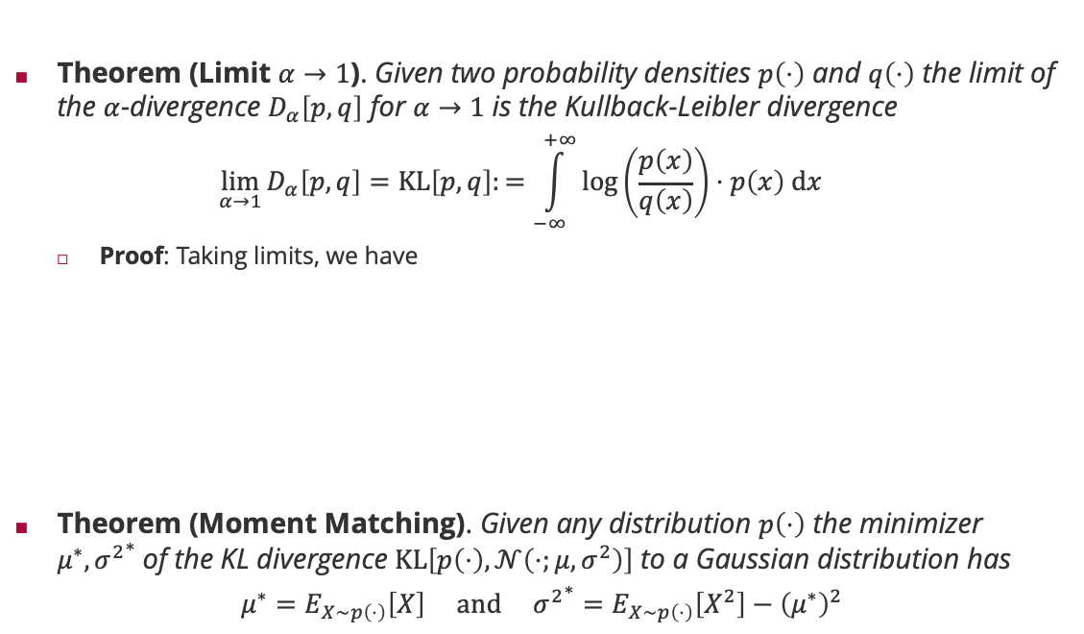
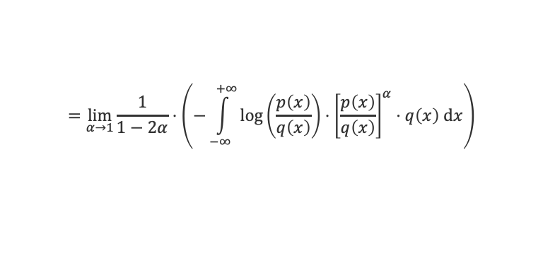

$α=1$: KL Divergence
Theorem (Limit $α→1$). Given two probability densities $p\left(⋅\right)$ and $q\left(⋅\right)$ the limit of the $α$-divergence $D_{α}\left[p,q\right]$ for $α→1$ is the Kullback-Leibler divergence
$$\lim_{α→1}{D_{α}\left[p,q\right]}=KL\left[p,q\right]:=\int_{−∞}^{+∞}{\log\left(\frac{p\left(x\right)}{q\left(x\right)}\right)⋅p\left(x\right) dx}$$
Proof: Taking limits, we have
Theorem (Moment Matching). Given any distribution $p\left(⋅\right)$ the minimizer $μ^{∗},{σ^{2}}^{∗}$of the KL divergence $KL\left[p\left(⋅\right),𝒩\left(⋅;μ,σ^{2}\right)\right]$ to a Gaussian distribution has
$$μ^{∗}=E_{X∼p\left(⋅\right)}\left[X\right] and {σ^{2}}^{∗}=E_{X∼p\left(⋅\right)}\left[X^{2}\right]−{\left(μ^{∗}\right)}^{2}$$
Solomon Kullback (1909 – 1994)
$$\lim_{α→1}{D_{α}\left[p,q\right]}=\lim_{α→1}{\frac{1}{α\left(1−α\right)}⋅\left(1−\int_{−∞}^{+∞}{{\left[\frac{p\left(x\right)}{q\left(x\right)}\right]}^{α}⋅q\left(x\right) dx}\right)}$$
L'Hôpital's rule!
Note that $\frac{d}{dz} b^{z}=\log\left(b\right)⋅b^{z}$
$$=\lim_{α→1}{\frac{1}{1−2α}⋅\left(−\int_{−∞}^{+∞}{{\log\left(\frac{p\left(x\right)}{q\left(x\right)}\right)⋅\left[\frac{p\left(x\right)}{q\left(x\right)}\right]}^{α}⋅q\left(x\right) dx}\right)}$$
Richard Leibler (1914 – 2003)
$$=\int_{−∞}^{+∞}{\log\left(\frac{p\left(x\right)}{q\left(x\right)}\right)⋅p\left(x\right) dx}$$

Slide 8
Overview
Distance Measures for Distributions
Approximating Marginals: Expectation Propagation
Approximating Normalization Constants

Slide 9
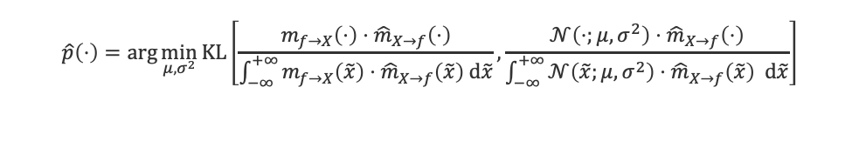
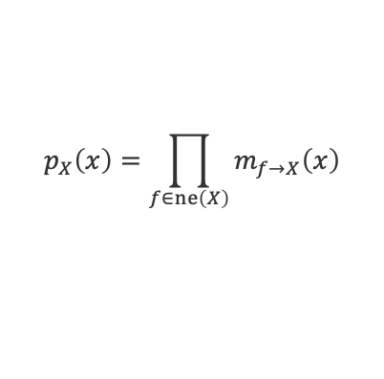
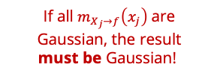

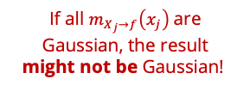

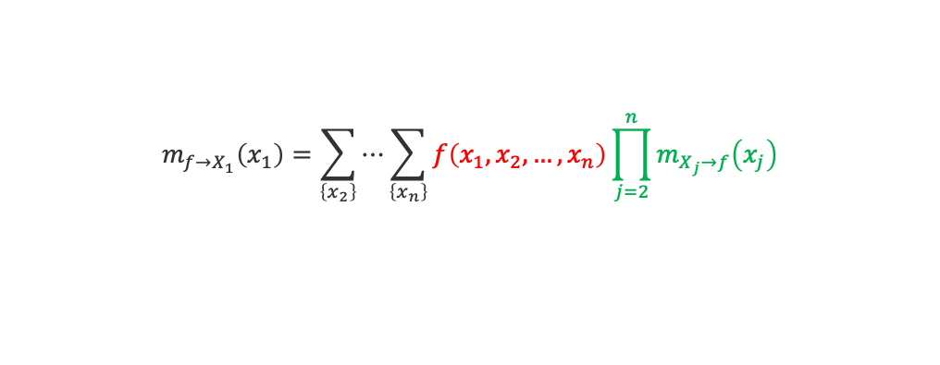
Sum-Product Algorithm Revisited
The key operation for factor $f\left(x_{1},x_{2},…,x_{n}\right)$ and variable $X_{1}$is
Based on outgoing messages, we can compute both non-normalized marginals $p_{X}\left(⋅\right)$ and $m_{X→f}\left(⋅\right)$
Idea:
We approximate all outgoing messages $m_{f→X}\left(⋅\right)$ by a Gaussian ${\hat{m}}_{f→X}\left(⋅\right)=𝒩\left(⋅;μ,σ^{2}\right)$
We measure the approximation quality in the normalized marginal, not the outgoing message
$$m_{f→X_{1}}\left(x_{1}\right)=\sum_{\left\{x_{2}\right\}}{⋯\sum_{\left\{x_{n}\right\}}{f\left(x_{1},x_{2},…,x_{n}\right)\prod_{j=2}^{n}{m_{X_{j}→f}\left(x_{j}\right)}}}$$
If all $m_{X_{j}→f}\left(x_{j}\right)$are Gaussian, the result might not be Gaussian!
$$p_{X}\left(x\right)=\prod_{f∈ne\left(X\right)}{m_{f→X}\left(x\right)}$$
$$m_{X→f}\left(x\right)=\frac{p_{X}\left(x\right)}{m_{f→X}\left(x\right)}$$
If all $m_{X_{j}→f}\left(x_{j}\right)$are Gaussian, the result must be Gaussian!
$$\hat{p}\left(⋅\right)=\arg{\min_{μ,σ^{2}}{KL\left[\frac{m_{f→X}\left(⋅\right)⋅{\hat{m}}_{X→f}\left(⋅\right)}{\int_{−∞}^{+∞}{m_{f→X}\left(\tilde{x}\right)⋅{\hat{m}}_{X→f}\left(\tilde{x}\right) d\tilde{x}}}, \frac{{𝒩\left(⋅;μ,σ^{2}\right)⋅\hat{m}}_{X→f}\left(⋅\right)}{\int_{−∞}^{+∞}{{𝒩\left(\tilde{x};μ,σ^{2}\right)⋅\hat{m}}_{X→f}\left(\tilde{x}\right) d\tilde{x}}}\right]}}$$
True normalized marginal with approximate incoming message
Approximate marginal with approximate incoming message

Slide 10
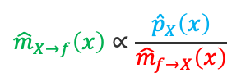

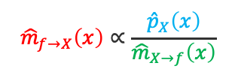

Approximate Message Passing: Example
$$f\left(x\right)=𝕀\left(x>0\right)$$
$${\hat{m}}_{X→f}\left(x\right)∝\frac{{\hat{p}}_{X}\left(x\right)}{{\hat{m}}_{f→X}\left(x\right)}$$
$${\hat{m}}_{f→X}\left(x\right)∝\frac{{\hat{p}}_{X}\left(x\right)}{{\hat{m}}_{X→f}\left(x\right)}$$
$$p_{X}\left(x\right)∝f\left(x\right)⋅{\hat{m}}_{X→f}\left(x\right)$$
$${\hat{p}}_{X}\left(x\right)=𝒩\left(x;E_{X∼p_{X}}\left[X\right],{var}_{X∼p_{X}}\left[X\right] \right)$$

Slide 11



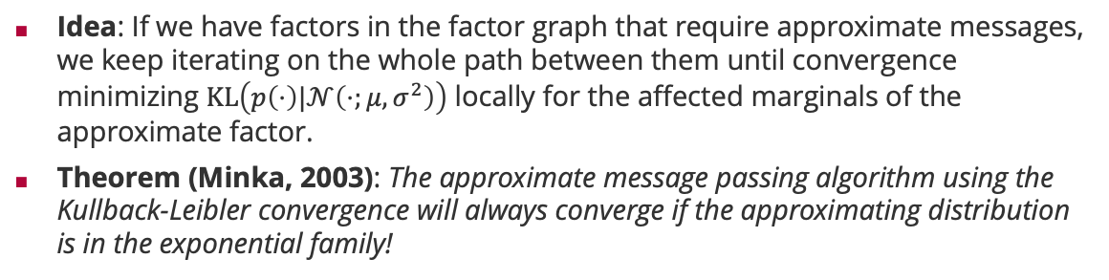



Expectation Propagation
Idea: If we have factors in the factor graph that require approximate messages, we keep iterating on the whole path between them until convergence minimizing $KL\left(p\left(⋅\right)|𝒩\left(⋅;μ,σ^{2}\right)\right)$ locally for the affected marginals of the approximate factor.
Theorem (Minka, 2003): The approximate message passing algorithm using the Kullback-Leibler convergence will always converge if the approximating distribution is in the exponential family!
Tom Minka
1
1
1
$$X_{1}$$
$$X_{2}$$
$$X_{5}$$
8
4
7
8
2
5
$$X_{3}$$
$$X_{4}$$
3
6
iterate until convergence

Slide 12

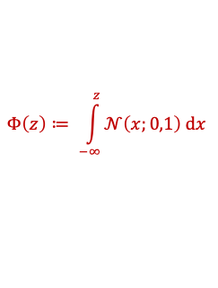

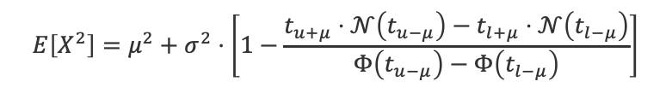
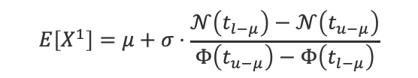


Doubly-Truncated Gaussians
Doubly-Truncated Gaussian. Given $l,u∈ℝ$, $μ∈ℝ$ and $σ^{2}∈ℝ^{+}$, a random variable $X$ has a doubly-truncated Gaussian distribution if
Moments of Doubly-Truncated Gaussian. Given a random variable $X$ that has a doubly-truncated Gaussian distribution and $t_{a}≔a/σ$, we know
$$p_{X}\left(x\right)∝𝕀\left(l<x<u\right)⋅𝒩\left(x;μ,σ^{2}\right)$$
$$Φ\left(z\right)≔ \int_{−∞}^{z}{𝒩\left(x;0,1\right) dx}$$
$$E\left[X^{0}\right]=Φ\left(t_{u−μ}\right)−Φ\left(t_{l−μ}\right)$$
$$E\left[X^{1}\right]=μ+σ⋅\frac{𝒩\left(t_{l−μ}\right)−𝒩\left(t_{u−μ}\right)}{Φ\left(t_{u−μ}\right)−Φ\left(t_{l−μ}\right)}$$
Additive correction that goes to zero as $u→∞$ and $l→−∞$
$$E\left[X^{2}\right]=μ^{2}+σ^{2}⋅\left[1−\frac{t_{u+μ}⋅𝒩\left(t_{u−μ}\right)−t_{l+μ}⋅𝒩\left(t_{l−μ}\right)}{Φ\left(t_{u−μ}\right)−Φ\left(t_{l−μ}\right)}\right]$$
Multiplicative correction that goes to one as $u→∞$ and $l→−∞$

Slide 13









Doubly-Truncated Gaussians (ctd)
Using the variance decomposition theorem we see
$$E\left[X\right]=μ+σ⋅v_{\frac{l}{σ},\frac{u}{σ}}\left(\frac{μ}{σ}\right)$$
$$var\left[X\right]=σ^{2}⋅\left[1−w_{\frac{l}{σ},\frac{u}{σ}}\left(\frac{μ}{σ}\right)\right]$$
$$v_{l,u}\left(z\right):=\frac{𝒩\left(l−z\right)−𝒩\left(u−z\right)}{Φ\left(u−z\right)−Φ\left(l−z\right)}$$
$$w_{l,u}\left(z\right):=\frac{\left(u+z\right)⋅𝒩\left(u−z\right)−\left(l+z\right)⋅𝒩\left(l−z\right)}{Φ\left(u−z\right)−Φ\left(l−z\right)}+v_{l,u}\left(z\right)⋅\left[2z+v_{l,u}\left(z\right)\right]$$
$$x<0$$
$$−5≤x<0$$
$$−3≤x<3$$
$$0≤x$$
$$v(t)$$
$$w(t)$$

Slide 14
Overview
Distance Measures for Distributions
Approximating Marginals: Expectation Propagation
Approximating Normalization Constants

Slide 15






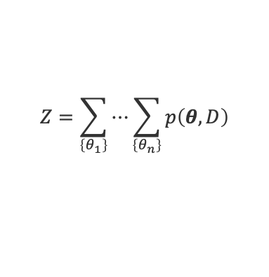
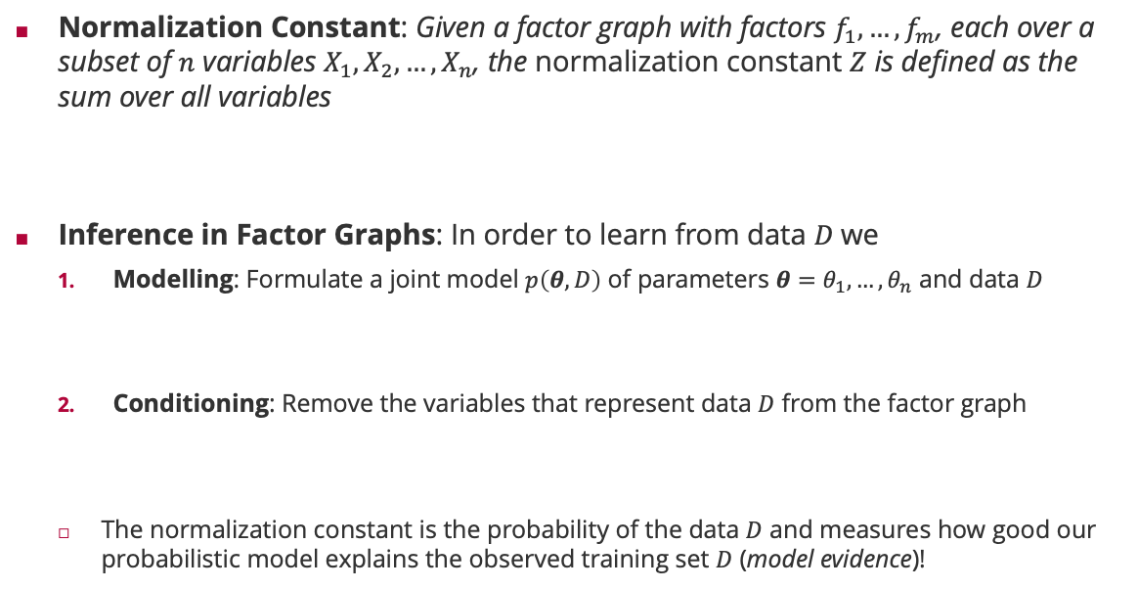









Normalization Constant
Normalization Constant: Given a factor graph with factors $f_{1}, …,f_{m}$, each over a subset of $n$ variables $X_{1},X_{2},…,X_{n}$, the normalization constant $Z$ is defined as the sum over all variables
Inference in Factor Graphs: In order to learn from data $D$we
Modelling: Formulate a joint model $p\left(θ,D\right)$ of parameters $θ=θ_{1},…,θ_{n}$ and data $D$
Conditioning: Remove the variables that represent data $D$ from the factor graph
The normalization constant is the probability of the data $D$ and measures how good our probabilistic model explains the observed training set $D$ (model evidence)!
$$S_{1}$$
$$S_{2}$$
$$Z=\sum_{\left\{x_{1}\right\}}{⋯\sum_{\left\{x_{n}\right\}}{f_{1}\left(x_{ne\left(f_{1}\right)}\right)⋅f_{2}\left(x_{ne\left(f_{2}\right)}\right)⋯f_{m}\left(x_{ne\left(f_{m}\right)}\right)}}$$
$$P_{1}$$
$$P_{2}$$
$$Y$$
$$p\left(S_{1},S_{2},P_{1},P_{2},Y\right)$$
$$Z=\sum_{\left\{θ_{1}\right\}}{⋯\sum_{\left\{θ_{n}\right\}}{\sum_{\left\{D\right\}}{p\left(θ,D\right)}}}$$
$$=1$$
$$S_{1}$$
$$S_{2}$$
$$Z=\sum_{\left\{θ_{1}\right\}}{⋯\sum_{\left\{θ_{n}\right\}}{p\left(θ,D\right)}}$$
Law of total probability
$$=p\left(D\right)$$
$$P_{1}$$
$$P_{2}$$
$$p\left(S_{1},S_{2},P_{1},P_{2},Y=1\right)$$

Slide 16



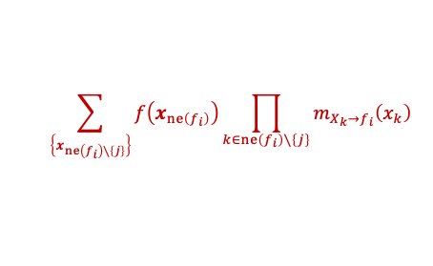
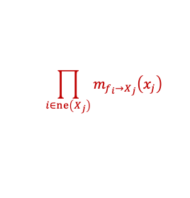
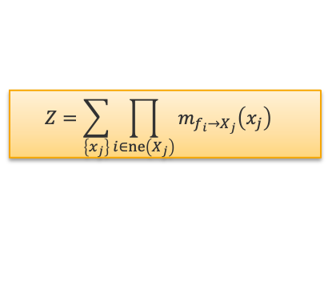





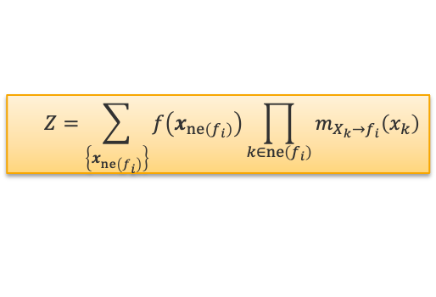

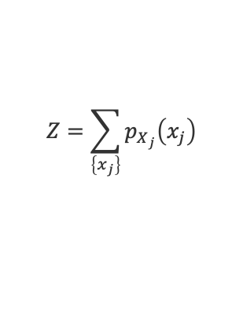






Normalization Constant via Message Passing
The non-normalized marginal $p_{X_{j}}\left(⋅\right)$ is defined as
$$p_{X_{j}}\left(x_{j}\right)=\sum_{\left\{x_{1}\right\}}{⋯\sum_{\left\{x_{j−1}\right\}}{\sum_{\left\{x_{j+1}\right\}}{⋯\sum_{\left\{x_{n}\right\}}{f_{1}\left(x_{ne\left(f_{1}\right)}\right)⋅f_{2}\left(x_{ne\left(f_{2}\right)}\right)⋯f_{m}\left(x_{ne\left(f_{m}\right)}\right)}}}}$$
$$m_{f_{i}→X_{j}}\left(x_{j}\right)⋅m_{X_{j}→f_{i}}\left(x_{j}\right)$$
$$\prod_{i∈ne\left(X_{j}\right)}{m_{f_{i}→X_{j}}\left(x_{j}\right)}$$
$$Z=\sum_{\left\{x_{j}\right\}}{p_{X_{j}}\left(x_{j}\right)}$$
$$\sum_{\left\{x_{ne\left(f_{i}\right)∖\left\{j\right\}}\right\}}{f\left(x_{ne\left(f_{i}\right)}\right)\prod_{k∈ne\left(f_{i}\right)∖\left\{j\right\}}{m_{X_{k}→f_{i}}\left(x_{k}\right)}}$$
Variable node root
Factor node root
$$Z=\sum_{\left\{x_{j}\right\}}{\prod_{i∈ne\left(X_{j}\right)}{m_{f_{i}→X_{j}}\left(x_{j}\right)}}$$
$$Z=\sum_{\left\{x_{ne\left(f_{i}\right)}\right\}}{f\left(x_{ne\left(f_{i}\right)}\right)\prod_{k∈ne\left(f_{i}\right)}{m_{X_{k}→f_{i}}\left(x_{k}\right)}}$$
$$m_{f_{1}→P_{1}}\left(p_{1}\right)$$
$$P_{1}$$
$$m_{f_{2}→P_{1}}\left(p_{1}\right)$$
$$m_{P_{2}→f_{1}}\left(p_{2}\right)$$
$$m_{P_{1}→f_{1}}\left(p_{1}\right)$$
$$P_{2}$$
$$P_{1}$$
$$P_{2}$$
$$S_{1}$$
$$S_{2}$$
$$S_{1}$$
$$S_{2}$$

Slide 17





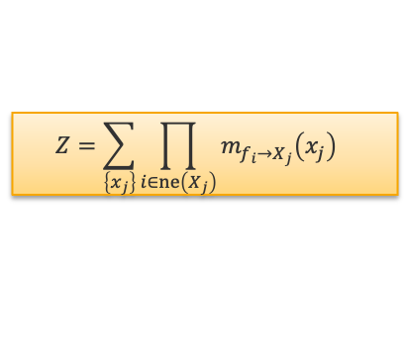

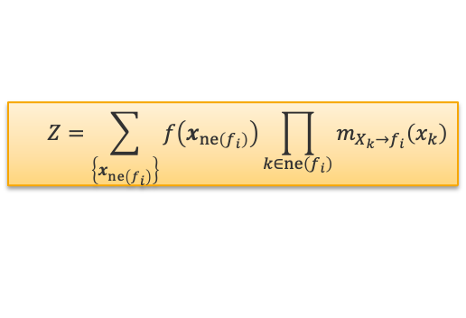







Normalization Constant via Message Passing: Example
$$𝒩\left(s_{1};μ_{1},σ_{1}^{2}\right)⋅𝒩\left(s_{2};μ_{2},σ_{2}^{2}\right)⋅𝒩\left(p_{1};s_{1},β^{2}\right)⋅𝒩\left(p_{2};s_{2},β^{2}\right)⋅𝕀\left(y\left(p_{1}−p_{2}\right)>0\right)$$
$$S_{1}$$
$$S_{2}$$
Variable node root
Factor node root
$$Z=\sum_{\left\{x_{j}\right\}}{\prod_{i∈ne\left(X_{j}\right)}{m_{f_{i}→X_{j}}\left(x_{j}\right)}}$$
$$Z=\sum_{\left\{x_{ne\left(f_{i}\right)}\right\}}{f\left(x_{ne\left(f_{i}\right)}\right)\prod_{k∈ne\left(f_{i}\right)}{m_{X_{k}→f_{i}}\left(x_{k}\right)}}$$
$$P_{1}$$
$$P_{2}$$
$$Y$$
$$P_{1}$$
$$P_{2}$$
$$P_{1}$$
$$P_{2}$$
$$S_{1}$$
$$S_{2}$$
$$S_{1}$$
$$S_{2}$$

Slide 18


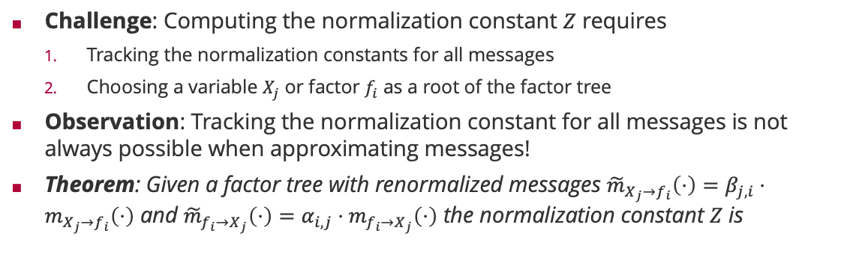
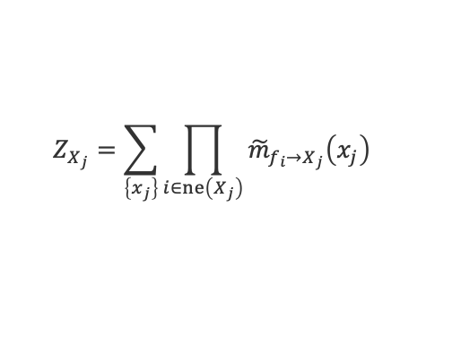
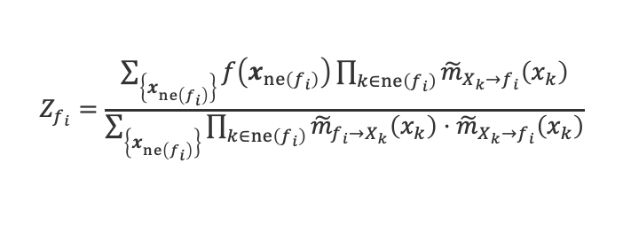


Normalization Constant via Approximate Message Passing
Challenge: Computing the normalization constant $Z$ requires
Tracking the normalization constants for all messages
Choosing a variable $X_{j}$ or factor $f_{i}$ as a root of the factor tree
Observation: Tracking the normalization constant for all messages is not always possible when approximating messages!
Theorem: Given a factor tree with renormalized messages ${\tilde{m}}_{X_{j}→f_{i}}\left(⋅\right)=β_{j,i}⋅m_{X_{j}→f_{i}}\left(⋅\right)$ and ${\tilde{m}}_{f_{i}→X_{j}}\left(⋅\right)=α_{i,j}⋅m_{f_{i}→X_{j}}\left(⋅\right)$ the normalization constant $Z$ is
$$P_{2}$$
$$P_{1}$$
$$𝕀\left(P_{1}>P_{2}\right)$$
$$Z=\left(\prod_{i=1}^{m}{Z_{f_{i}}}\right)⋅\left(\prod_{j=1}^{n}{Z_{X_{j}}}\right)$$
Factor Normalization
Variable Normalization
$$Z_{f_{i}}=\frac{\sum_{\left\{x_{ne\left(f_{i}\right)}\right\}}{f\left(x_{ne\left(f_{i}\right)}\right)\prod_{k∈ne\left(f_{i}\right)}{{\tilde{m}}_{X_{k}→f_{i}}\left(x_{k}\right)}}}{\sum_{\left\{x_{ne\left(f_{i}\right)}\right\}}{\prod_{k∈ne\left(f_{i}\right)}{{\tilde{m}}_{f_{i}→X_{k}}\left(x_{k}\right)⋅{\tilde{m}}_{X_{k}→f_{i}}\left(x_{k}\right)}}}$$
$$Z_{X_{j}}=\sum_{\left\{x_{j}\right\}}{\prod_{i∈ne\left(X_{j}\right)}{{\tilde{m}}_{f_{i}→X_{j}}\left(x_{j}\right)}}$$

Slide 19
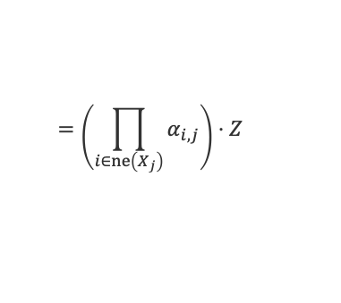
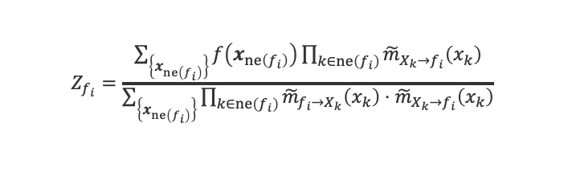
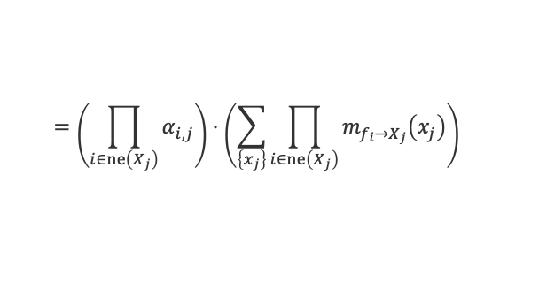



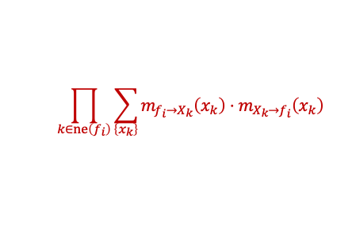
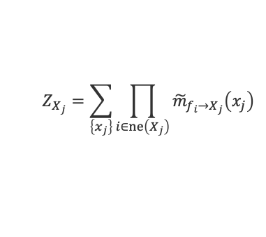
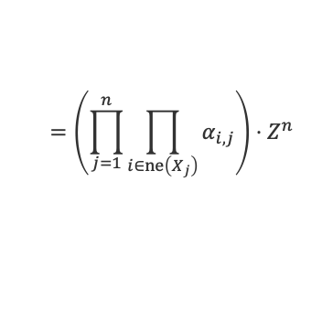


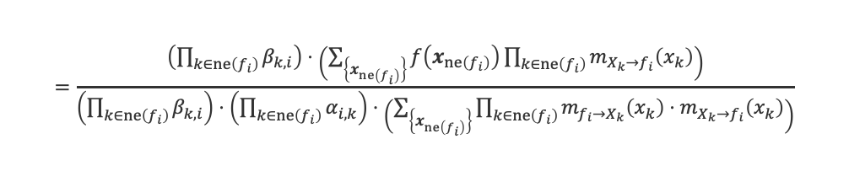
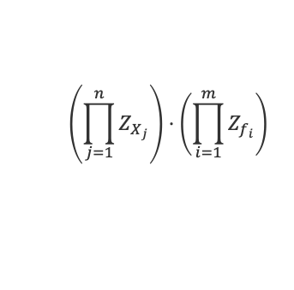

Proof of Normalization Theorem
Simplifying the variable normalization $Z_{X_{j}}$ and factor normalization $Z_{f_{i}}$
Variable normalization
Factor normalization
$$β_{k,i}⋅m_{X_{k}→f_{i}}\left(x_{k}\right)$$
$$α_{i,j}⋅m_{f_{i}→X_{j}}\left(x_{j}\right)$$
$$Z_{X_{j}}=\sum_{\left\{x_{j}\right\}}{\prod_{i∈ne\left(X_{j}\right)}{{\tilde{m}}_{f_{i}→X_{j}}\left(x_{j}\right)}}$$
$$Z_{f_{i}}=\frac{\sum_{\left\{x_{ne\left(f_{i}\right)}\right\}}{f\left(x_{ne\left(f_{i}\right)}\right)\prod_{k∈ne\left(f_{i}\right)}{{\tilde{m}}_{X_{k}→f_{i}}\left(x_{k}\right)}}}{\sum_{\left\{x_{ne\left(f_{i}\right)}\right\}}{\prod_{k∈ne\left(f_{i}\right)}{{\tilde{m}}_{f_{i}→X_{k}}\left(x_{k}\right)⋅{\tilde{m}}_{X_{k}→f_{i}}\left(x_{k}\right)}}}$$
$$Z$$
$$Z$$
$$=\left(\prod_{i∈ne\left(X_{j}\right)}{α_{i,j}}\right)⋅\left(\sum_{\left\{x_{j}\right\}}{\prod_{i∈ne\left(X_{j}\right)}{m_{f_{i}→X_{j}}\left(x_{j}\right)}}\right)$$
$$=\frac{\left(\prod_{k∈ne\left(f_{i}\right)}{β_{k,i}}\right)⋅\left(\sum_{\left\{x_{ne\left(f_{i}\right)}\right\}}{f\left(x_{ne\left(f_{i}\right)}\right)\prod_{k∈ne\left(f_{i}\right)}{m_{X_{k}→f_{i}}\left(x_{k}\right)}}\right)}{\left(\prod_{k∈ne\left(f_{i}\right)}{β_{k,i}}\right)⋅\left(\prod_{k∈ne\left(f_{i}\right)}{α_{i,k}}\right)⋅\left(\sum_{\left\{x_{ne\left(f_{i}\right)}\right\}}{\prod_{k∈ne\left(f_{i}\right)}{m_{f_{i}→X_{k}}\left(x_{k}\right)⋅m_{X_{k}→f_{i}}\left(x_{k}\right)}}\right)}$$
$$=\left(\prod_{i∈ne\left(X_{j}\right)}{α_{i,j}}\right)⋅Z$$
$$=\frac{Z}{\left(\prod_{k∈ne\left(f_{i}\right)}{α_{i,k}}\right)⋅Z^{\left|ne\left(f_{i}\right)\right|}}$$
$$\prod_{k∈ne\left(f_{i}\right)}{\sum_{\left\{x_{k}\right\}}{m_{f_{i}→X_{k}}\left(x_{k}\right)⋅m_{X_{k}→f_{i}}\left(x_{k}\right)}}$$
$$\left(\prod_{j=1}^{n}{Z_{X_{j}}}\right)⋅\left(\prod_{i=1}^{m}{Z_{f_{i}}}\right)$$
$$=\left(\prod_{j=1}^{n}{\prod_{i∈ne\left(X_{j}\right)}{α_{i,j}}}\right)⋅Z^{n}$$
$$⋅\frac{Z^{m}}{\left(\prod_{i=1}^{m}{\prod_{k∈ne\left(f_{i}\right)}{α_{i,k}}}\right)⋅\prod_{i=1}^{m}{Z^{\left|ne\left(f_{i}\right)\right|}}}$$
$Z^{n+m−1}$ because
the factor graph
is a tree with
$n+m$ nodes!
identical

Slide 20

Summary
Distance Measures for Distributions
$α$-divergences are a general class of distance measures between distributions
For $α=1$, the $α$-divergence becomes the Kullback-Leibler divergence where the minimizer for Gaussian approximating distributions matches mean and variance
Minimizers of $α$-divergences range from mode-seeking to support-seeking
Approximate Message Passing and Expectation Propagation
Approximations will always be done on the marginals, not the messages
When the Kullback-Leibler divergence is used as distance, all moments get preserved
In case of doubly-truncated Gaussians, the moments are closed form
Approximating Normalization Constants
If factor graphs represent joint probabilities of data and parameters with data variables only, the normalization constant equals the probability of data (under the model)
If messages can be explicitly represented and normalized, efficient updates can be done starting at any factor or variable
There is a general distributed algorithm for approximating the normalization constant

Slide 21
See you next week!

